Slide 1
Copyright Notice
These slides are distributed under the Creative Commons License.
DeepLearning.AI makes these slides available for educational purposes. You may not use or distribute these slides for commercial purposes. You may make copies of these slides and use or distribute them for educational purposes as long as you cite DeepLearning.AI as the source of the slides.
For the rest of the details of the license, see https://creativecommons.org/licenses/by-sa/2.0/legalcode

Slide 2
Machine Learning
Welcome!

Slide 3
Machine Learning
Applications of Machine Learning

Slide 4
Machine Learning Overview
What is Machine Learning?

Slide 5
Machine learning
"Field of study that gives computers the ability to learn without being explicitly programmed."
Arthur Samuel (1959)

Slide 6

Question
If the checkers program had been allowed to play only ten games (instead of tens of thousands) against itself, a much smaller number of games, how would this have affected its performance?
Would have made it better Would have made it worse

Slide 7
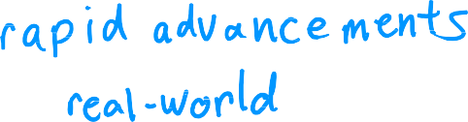














Machine learning algorithms
Supervised learning
Unsupervised learning
Recommender systems
Reinforcement learning
Practical advice for applying learning algorithms

Slide 8
Machine Learning Overview
Supervised Learning Part 1

Slide 9




Supervised learning
input
output label
Learns from being given "right answers"

Slide 10

Input (X)
Output (Y)
Application
email
spam? (0/1)
spam filtering
audio
text transcripts
speech recognition
English
Spanish
machine translation
ad, user info
click? (0/1)
online advertising
image, radar info
position of other cars
self-driving car
image of phone
defect? (0/1)
visual inspection

Slide 11

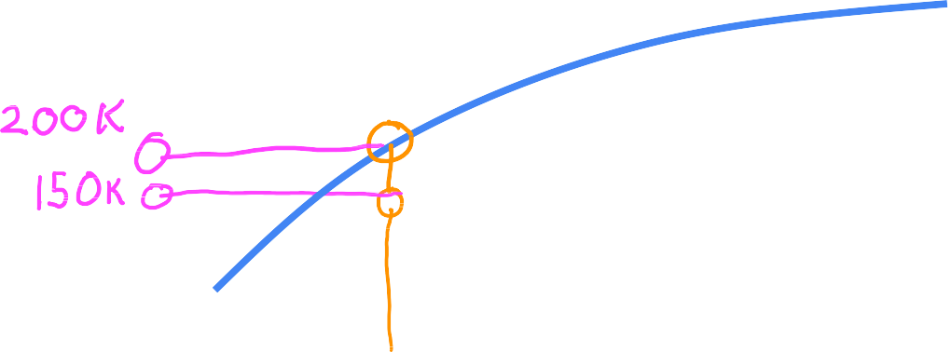














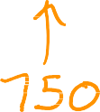
Regression: Housing price prediction
400
300
Price in
$1000's
200
100
0
0
500
1000 1500
House size in feet²
2000
2500
Regression
Predict a number
infinitely many possible outputs

Slide 12
Machine Learning Overview
Supervised Learning Part 2

Slide 13




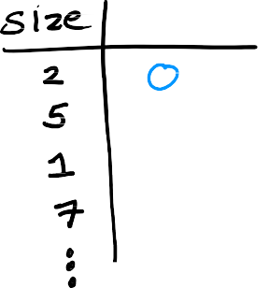






Classification: Breast cancer detection
1
0
tumor size x
(diameter in cm)
benign malignant

Slide 14











Classification: Breast cancer detection
benign
malignant
malignant type 2
0cm
diameter(cm)
10cm
Classification predict categories
small number of possible outputs

Slide 15











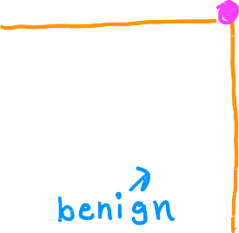




Two or more inputs
Age
Tumor size

Slide 16
Supervised learning
Learns from being given "right answers"
Regression
Predict a number
infinitely many possible outputs
Classification predict categories
small number of possible outputs

Slide 17
Machine Learning Overview
Unsupervised Learning Part 1

Slide 18

Previous: Supervised learning
Now: Unsupervised learning

Slide 19


Supervised learning Learn from data labeled with the "right answers"
Unsupervised learning Find something interesting in unlabeled data.
age
age
tumor size
tumor size

Slide 20









Clustering: Google news

Slide 21



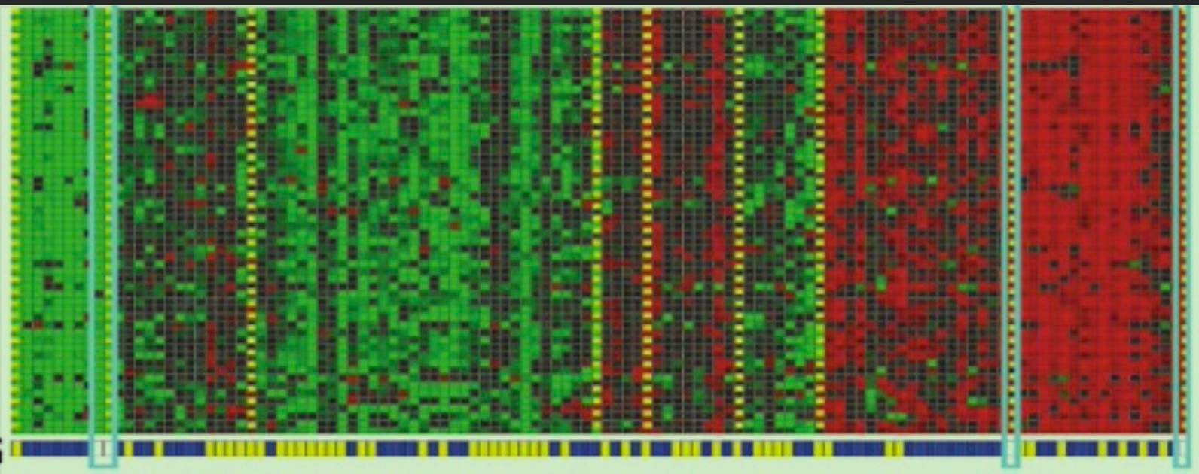







Clustering: DNA microarray
genes
(each row)
individuals
(each column)

Slide 22
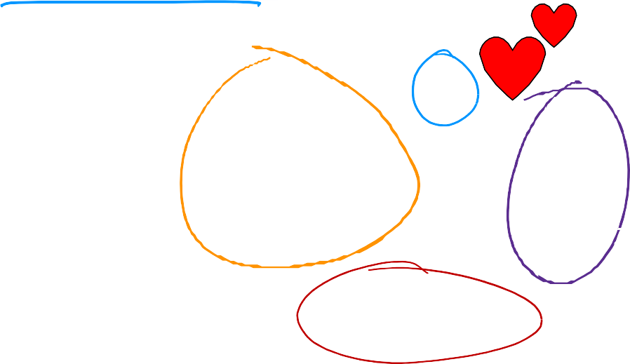

Clustering: Grouping customers
growing skills
and knowledge
develop
career
stay updated
with AI

Slide 23
Machine Learning Overview
Unsupervised Learning Part 2

Slide 24
Unsupervised learning
Data only comes with inputs x, but not output labels y.
Algorithm has to find structure in the data.
Clustering
Group similar data
points together.
Dimensionality reduction Compress data using fewer numbers.
Anomaly detection
Find unusual data points.

Slide 25

Question
Of the following examples, which would you address using
an unsupervised learning algorithm?
Given email labeled as spam/not spam, learn a spam filter.
Given a set of news articles found on the web, group them into sets
of articles about the same story.
Given a database of customer data, automatically discover market segments and group customers into different market segments.
Given a dataset of patients diagnosed as either having diabetes or not, learn to classify new patients as having diabetes or not

Slide 26
Linear Regression with One Variable
Linear Regression Model Part 1

Slide 27




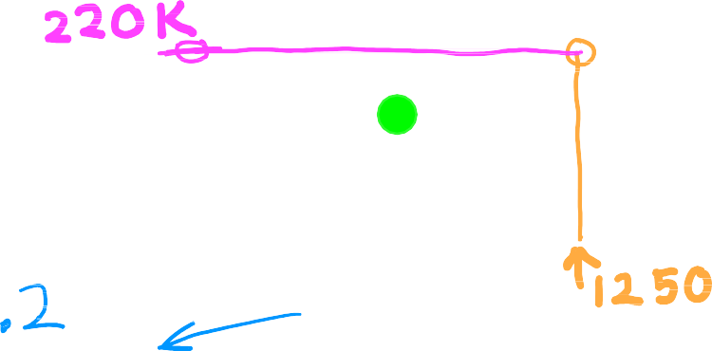









House sizes and prices
500
linear regression
400
price in
$1000's
300
200
100
0
1000
size in feet²
0
2000
3000
Regression model Predicts numbers
Supervised learning model
Data has "right answers"
Classification model
Predicts categories
Infinitely many possible outputs
Small number of possible outputs

Slide 28



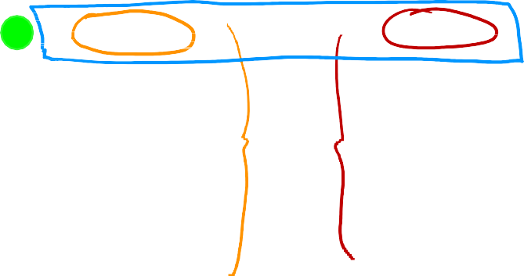



House sizes and prices
price in $1000's
Data table
size in feet² price in $1000's
500
400
2104
1416
1534
852
.
3210
400
232
315
178
.
870
300
200
100
0
0
1000
2000
size in feet²
3000

Slide 29
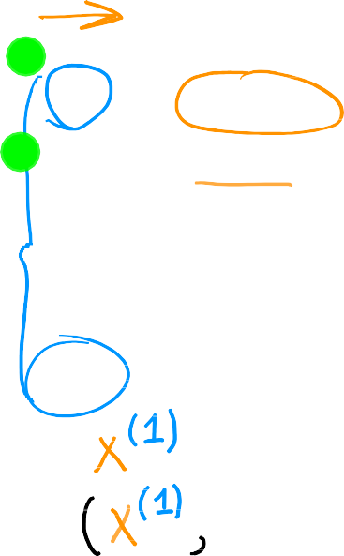




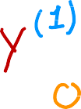



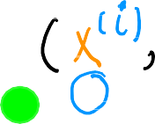










Terminology
Training Data used to train the model set:
Notation:
x = "input" variable
feature
y = "output" variable
"target" variable
m = number of training examples
x
y
price in $1000's
size in feet²
(1) | 2104 | 400
(2) | 1416 | 232
(3) | 1534 | 315
(4) | 852 | 178
. | . | .
(47) | 3210 | 870
= single training example
(x^{(i)}, y^{(i)}) = i^{th} training example
index
not exponent
(1st, 2nd, 3rd .)
x⁽²⁾ = 1416

Slide 30
Linear Regression with One Variable
Linear Regression Model Part 2

Slide 31

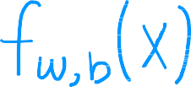



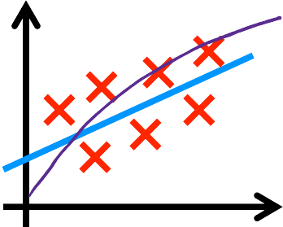














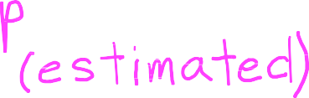



How to represent f?
training set
learning algorithm
x = wx + b f x = wx + b
"y-hat"
y�
^{f}w,b
x
f
y
prediction (estimated y)
target
feature
model
x
Linear regression with one variable.
Univariate linear regression.
Andrew Ng

Slide 32
Linear Regression with One Variable
Cost Function

Slide 33



Training set
size in feet² (x)
price $1000's (y)
Model: f_{w,b} x = wx + b
w, b: parameters
2104 | 460
1416 | 232
1534 | 315
852 | 178
. | .
What do w, b do?

Slide 34
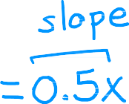






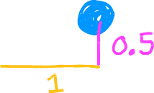
















^{f}w,b
x = wx + b
f(x)
3
3
3
2
2
2
1
1
1
0
0
0
1 2
w = 0
b = 1.5
1 2
w = 0.5
b = 0
1 2
w = 0.5
b = 1
0
3
0
3
0
3

Slide 35




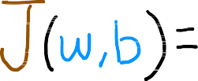
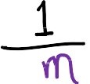
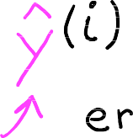




















Cost function: Squared error cost function
y
_{(x}(i)_{, y}(i)₎
^{f}w,b
m = number of training examples
x
y�^{(i)} = f_{w,b}
_{x} i
_{x} i
= wx^{(i)} + b
Find w, b:
y�^{(i)} is close to y^{(i)} for all (x ^{i} , y^{(i)}).
^{f}w,b

Slide 36
Linear Regression with One Variable
Cost Function Intuition

Slide 37





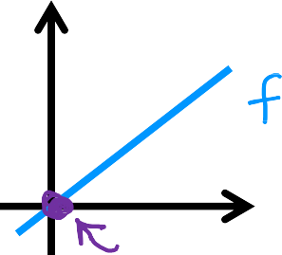







model:
simplified
f_{w} x = wx
^{f}w,b
x = wx + b
parameters:
w, b
cost function:
w
goal:
minimize J w, b
w,b
minimize J w
w

Slide 38

















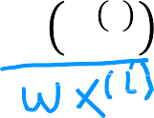


f_{w}(x)
(for fixed w, function of x)
input
J(w)
(function of w)
parameter
3
f_{w}
3
2
y
1
0
2
w = 1
J(w)
1
0
0
1
1
x
_{x} i
2
3
-0.5 0 0.5 1 1.5 2 2.5
w
m
m
1
L(wx ^{i} - y ^{i} )²
i=1
1
J(w) =
L(f
- y ^{i} )² =
= ( 0² +0² +0² ) = 0
2m
w
2m
2m
i=1

Slide 39







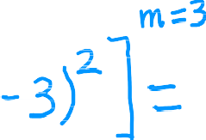
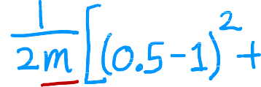
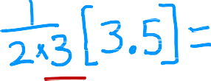






f_{w}(x)
(function of x)
J(w)
(function of w)
3
f_{w}(x)
3
2
2
y
J(w₁)
1
1
w = 0.5
0
0
0
1
2
3
-0.5
0 0.5 1 1.5 2 2.5
w
x
J 0.5 =

Slide 40







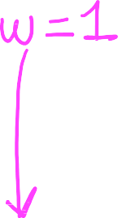







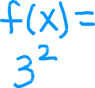


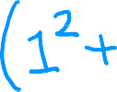







f_{w}(x)
(function of x)
J(w)
(function of w)
3
f_{w}
3
2
2
y
J(w)
1
1
w = 0
0
0
0
1
2
3
-0.5
0 0.5 1 1.5 2 2.5
w
x
J 0 =

Slide 41
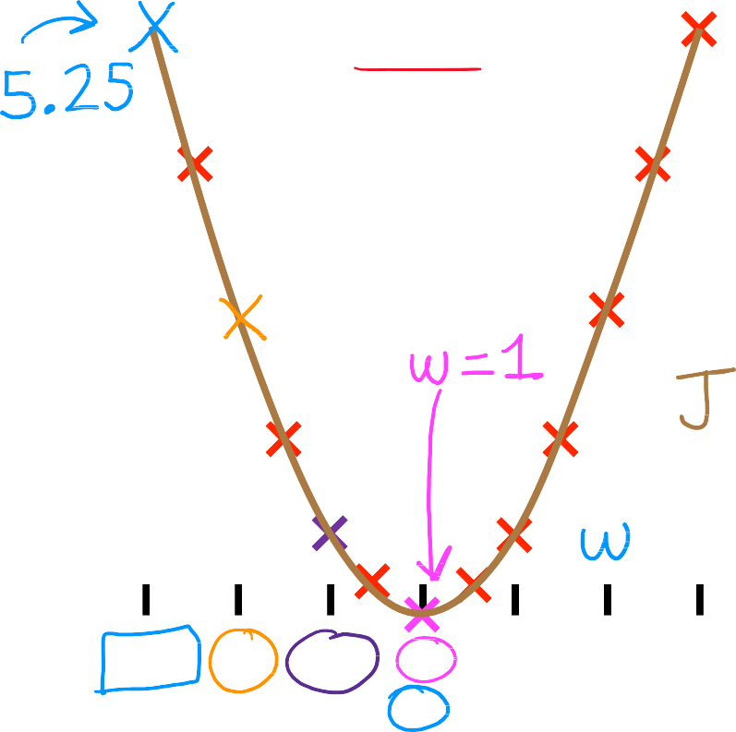



goal of linear regression:
J(w)
(function of w)
3
minimize J w
w
general case:
minimize J w, b
w,b
2
J(w)
1
0
-0.5
0 0.5 1 1.5 2 2.5
w

Slide 42
Linear Regression with One Variable
Visualizing the Cost Function

Slide 43



x = wx + b
Model
^{f}w,b
Parameters
w, b
Cost Function
Objective
minimize J w, b
w,b

Slide 44
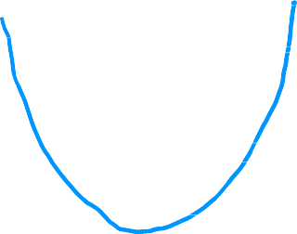






^{f}w,b
J
(function of x)
(function of w, b)
500
400
300
price in
$1000's
200
100
0
0
1000 2000
size in feet²
3000
^{f}w,b
x = 0.06x + 50

Slide 45
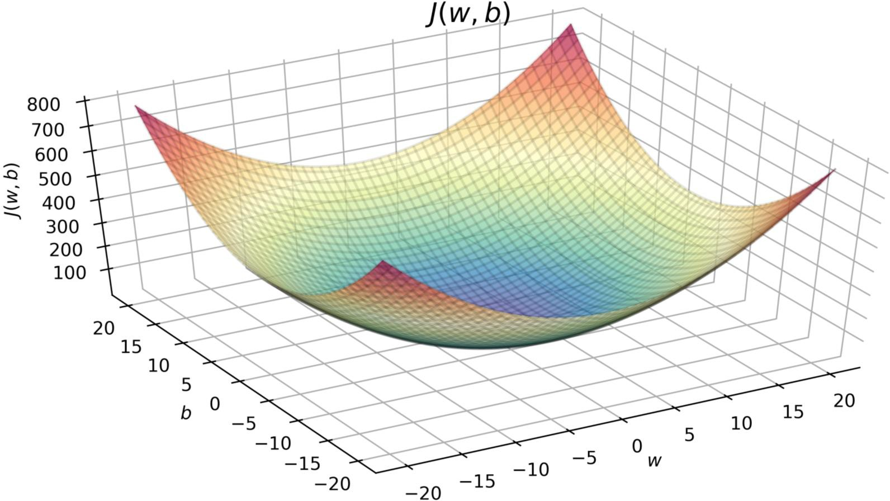


^{J}(w,b)
J w = -10, b = -15

Slide 46
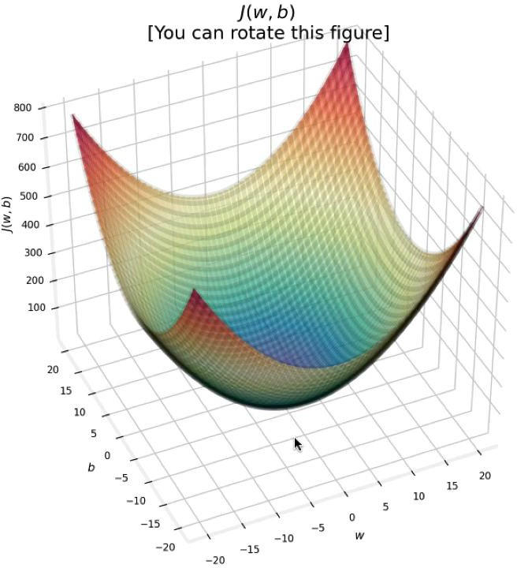



3D surface plot

Slide 47
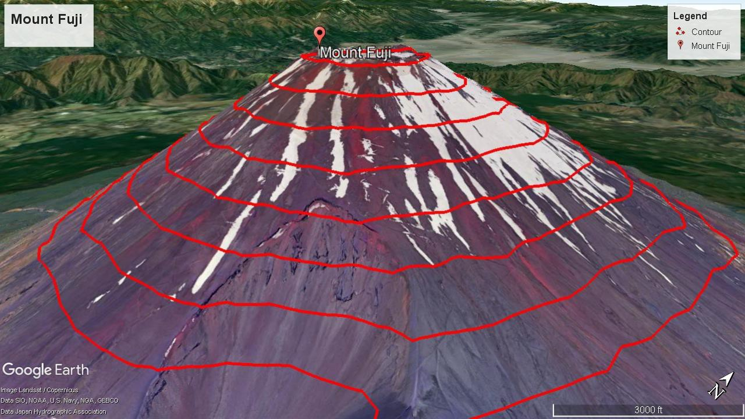

Slide 48
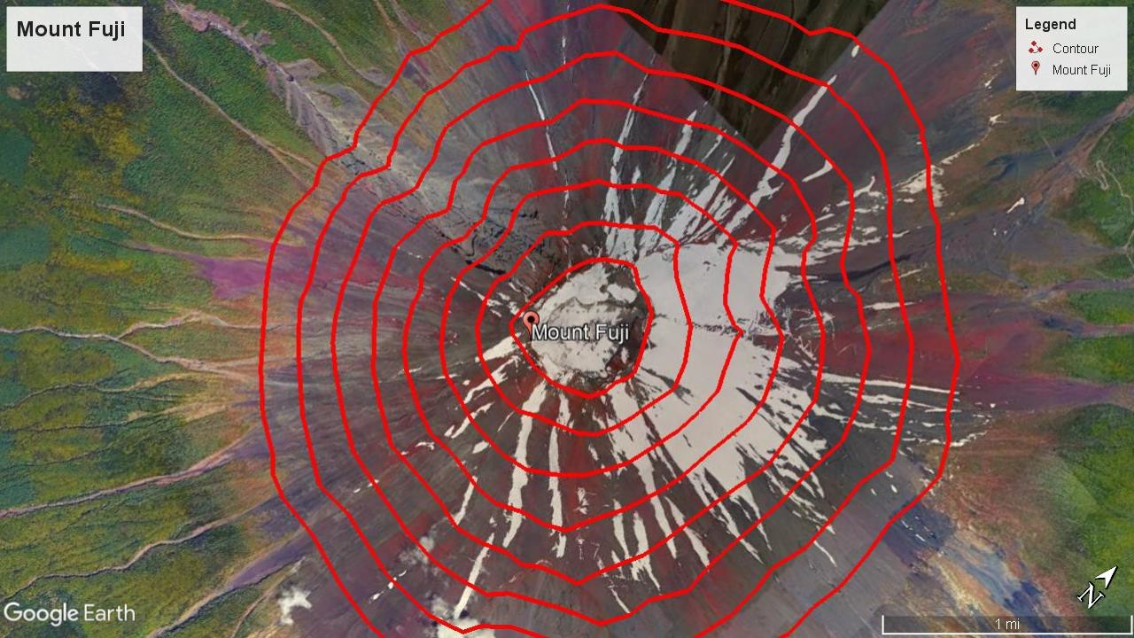

Slide 49
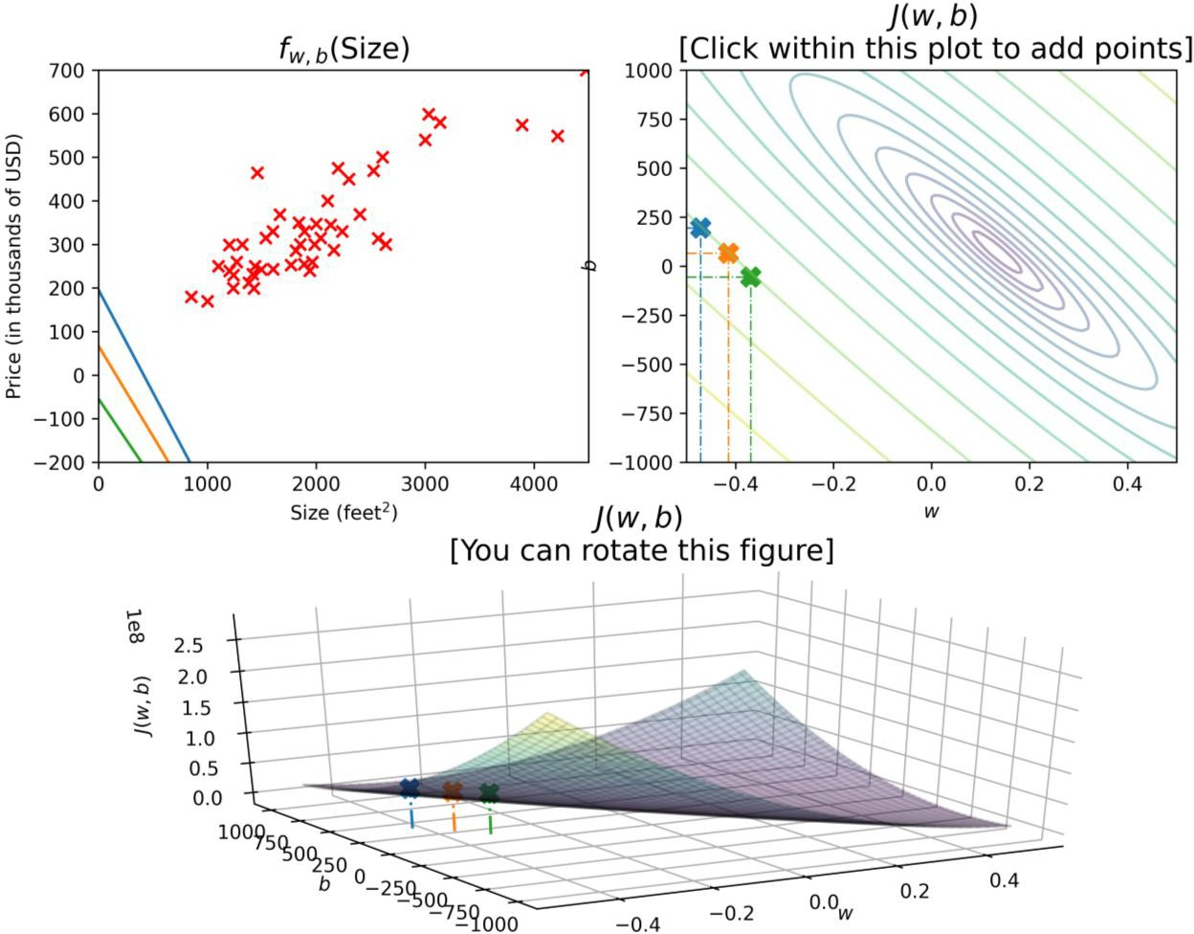






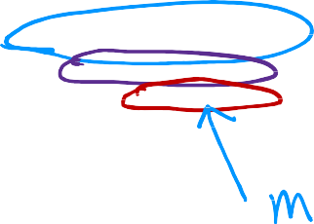


click within this plot to add points
pric e in
$1000's
size in feet²
 | you can rotate this figure

Slide 50
Linear Regression with One Variable
Visualization examples

Slide 51
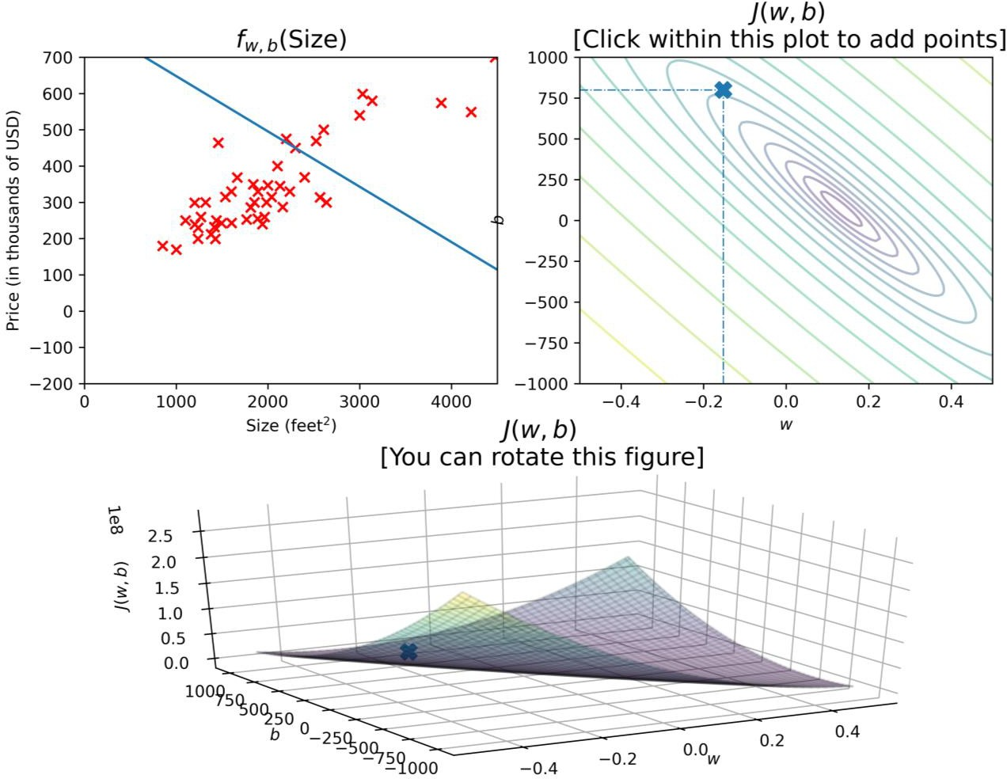








click within this plot to add points
pric e in
$1000's
size in feet²
 | you can rotate this figure

Slide 52
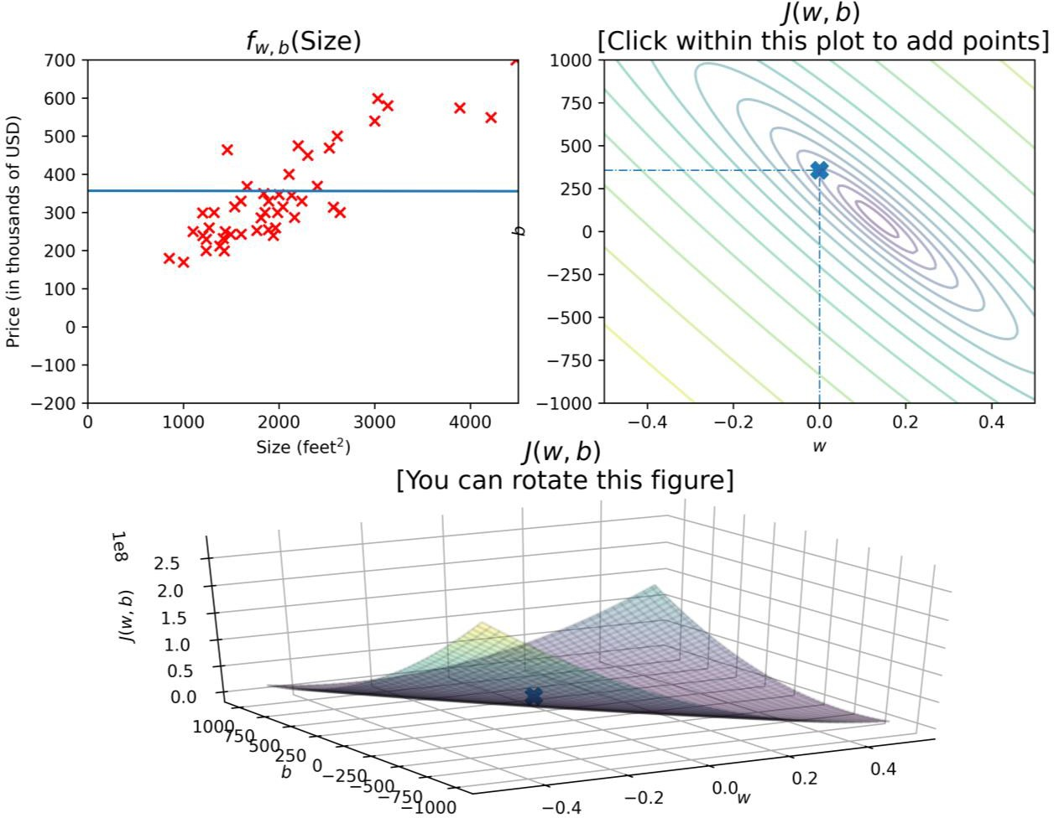




click within this plot to add points
pric e in
$1000's
size in feet²
 | you can rotate this figure

Slide 53
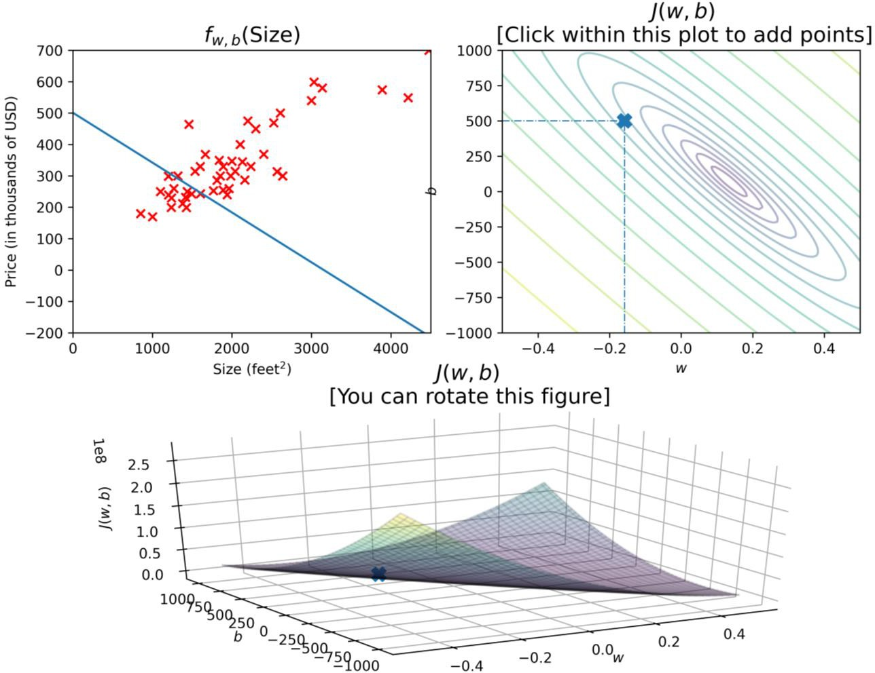



click within this plot to add points
pric e in
$1000's
size in feet²
 | you can rotate this figure

Slide 54
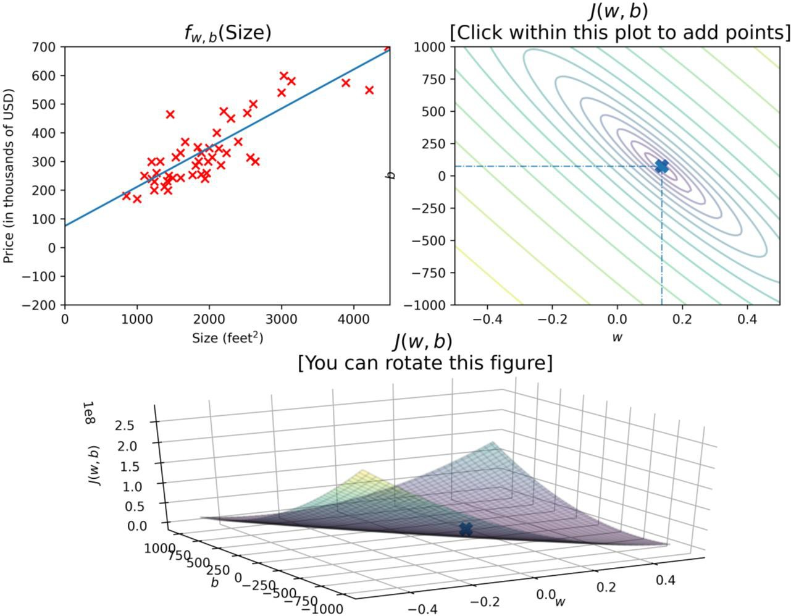






click within this plot to add points
pric e in
$1000's
size in feet²
 | you can rotate this figure

Slide 55
Training Linear Regression
Gradient Descent

Slide 56






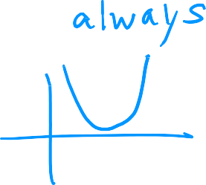







J w, b
Have some function
Want
min J w, b
w,b
min
w₁, .,w_{n},b
J w₁, w₂, . , w_{n}, b
Outline:
Start with some w, b
(set w=0, b=0)
Keep changing w, b to reduce J w, b
Until we settle at or near a minimum

Slide 57




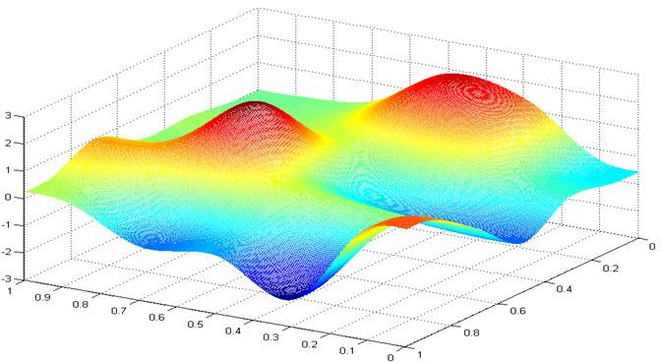
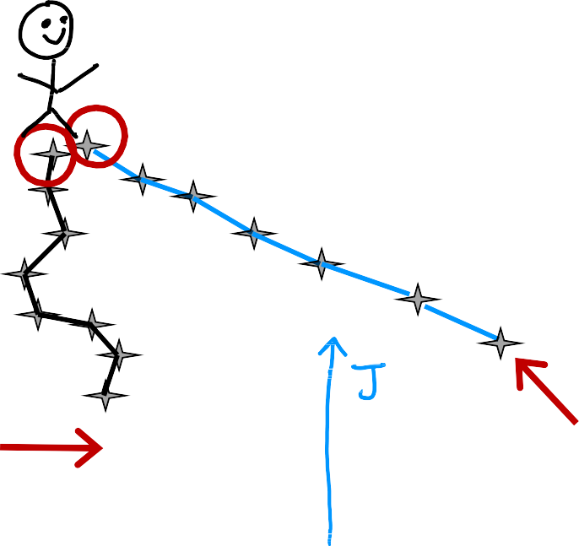

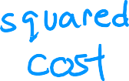
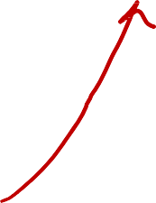







J w, b
b
w

Slide 58
Training Linear Regression
Implementing Gradient Descent

Slide 59





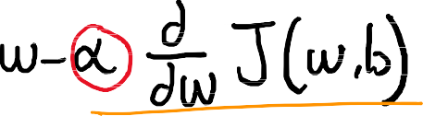









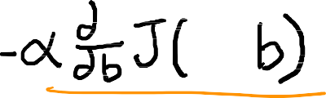








Gradient descent algorithm
Assignment
Truth assertion
Repeat until convergence
Learning rate Derivative
Simultaneously update w and b
Code
Math
a==c
Correct: Simultaneous update
a
tmp_w = w - a _{aw} J w, b
Incorrect
a
tmp_w = w - a J w, b
aw
a
tmp_b = b - a J w, b
w = tmp_w
a
ab
tmp_b = b - a J w, b
ab
b = tmp_b
w = tmp_w b = tmp_b
Andrew Ng

Slide 60
Training Linear Regression
Gradient Descent Intuition

Slide 61

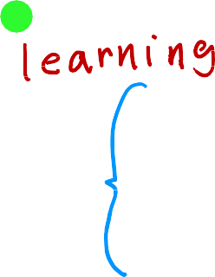
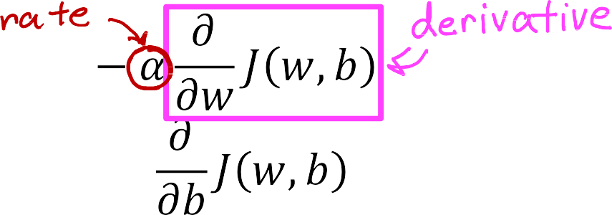
Gradient descent algorithm
repeat until convergence {
J w
min J w
w

Slide 62



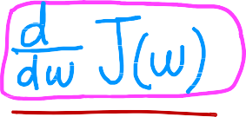












J(w)
J w
w
w = w - a ·
positive number
J(w)
d
J w
J w
dw
w = w - a ·
negative number
w

Slide 63
Training Linear Regression
Learning Rate

Slide 64


w = w - a
d
J w
dw
J(w)
minimum
If a is too small.
Gradient descent may be slow.
w
If a is too large.
Gradient descent may:
Overshoot, never reach minimum
Fail to converge, diverge
J(w)
w
minimum

Slide 65













J(w)
local minimum
w
current value of w
w = w - a · 0
w = w

Slide 66









Can reach local minimum with fixed learning rate
not as large
large
J w
Near a local minimum,
Derivative becomes smaller
Update steps become smaller
Can reach minimum without
decreasing learning rate
w
minimum

Slide 67
Training Linear Regression
Gradient Descent for Linear Regression

Slide 68
















Cost function
Linear regression model
f_{w,b}(x) = wx + b
Gradient descent algorithm
repeat until convergence {
}

Slide 69
































(Optional)
a
_{aw} J w, b =
a
J w, b =
ab

Slide 70














Gradient descent algorithm
repeat until convergence {
Update
w and b
simultaneously
}

Slide 71




More than one local minimum
J w, b
b
w

Slide 72




squared error cost
convex function
w
global minimum
b

Slide 73
Training Linear Regression
Running Gradient Descent

Slide 74










f_{w,b} size
J w, b
pric e in
$1000's
size in feet²
J w, b

Slide 75

f_{w,b} size
J w, b
f_{w,b} size
J w, b
J w, b
pric e in
$1000's
size in feet²
J w, b
size in feet²
J w, b

Slide 76

f_{w,b} size
J w, b
J w, b

Slide 77

f_{w,b} size
J w, b
f_{w,b} size
J w, b
pric e in
$1000's
size in feet²
J w, b
J w, b

Slide 78

f_{w,b} size
J w, b
pric e in
$1000's
size in feet²
J w, b

Slide 79

f_{w,b} size
J w, b
f_{w,b} size
J w, b
pric e in
$1000's
size in feet²
J w, b
J w, b

Slide 80

f_{w,b} size
J w, b
pric e in
$1000's
size in feet²
J w, b

Slide 81

f_{w,b} size
J w, b
pric e in
$1000's
size in feet²
J w, b

Slide 82



f_{w,b} size
J w, b
pric e in
$1000's
size in feet²
J w, b

Slide 83








"Batch" gradient descent
"Batch": Each step of gradient descent
uses all the training examples.
 | x size in feet² | y price in $1000's
(1) | 2104 | 400
(2) | 1416 | 232
(3) | 1534 | 315
(4) | 852 | 178
. | . | .
(47) | 3210 | 870

